Slide 1
Identifying and Describing Consonants
Introspective tasks and ear-training

Slide 2
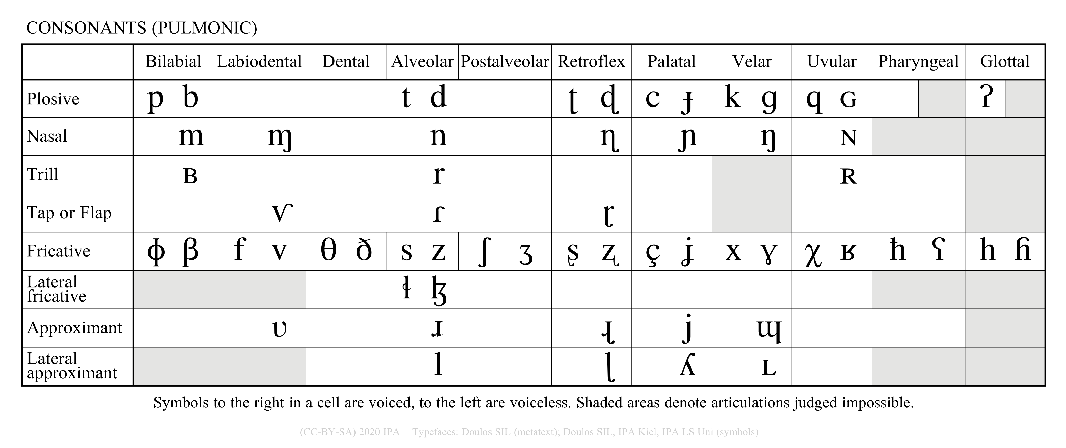

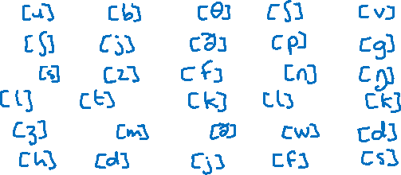
Describing consonants: introspective activity
Consider the English words below. Practice saying then and decide what consonant sound each contains.
Think about voicing, place, and manner of articulation
Use the pulmonic consonants portion of the IPA chart to choose the best symbol to represent each sound.
NOTE: You won’t be able to find one sound on the chart. Where is it hiding on the full IPA chart? Why?
The consonants in <joy> and <Chi> are affricates. How should they be transcribed?
Click on the question mark to see the answers. →
awry | baby | thaw | ash | ava
show | you | they | app | ago
seesaw | easy | off | annie | ang
all | it | awk | lie | icky!
asia | maam | though | away | day
haa! | add | yoyo | pho | ace
Note: you may have slightly different answers for some of these depending on your accent.
Created by Antoin Rodgers under Creative Commons Attribution-ShareAlike 4.0 License - rodgeran@tcd.ie - @phonetic_antoin

Slide 3















Describing consonants: ear training
1 | 2 | 3 | 4 | 5
6 | 7 | 8 | 9 | 10
11 | 12 | 13 | 14 | 15
16 | 17 | 18 | 19 | 20
21 | 22 | 23
Click to listen to each sound on this side.
One sound is a voiceless consonant but is not represented on the pulmonic consonant chart. To transcribe it, you need to use the voiceless diacritic, which is a small circle below the symbol [◌̥] (called an under-ring).
The answers are on the next slide.
Click on the question mark for some clues. →
Created by Antoin Rodgers under Creative Commons Attribution-ShareAlike 4.0 License - rodgeran@tcd.ie - @phonetic_antoin

Slide 4




Describing consonants: ear training
1 | 2 | 3 | 4 | 5
6 | 7 | 8 | 9 | 10
11 | 12 | 13 | 14 | 15
16 | 17 | 18 | 19 | 20
21 | 22 | 23
Click to listen to each sound on this side.
One sound is a voiceless consonant but is not represented on the pulmonic consonant chart. To transcribe it, you need to use the voiceless diacritic, which is a small circle below the symbol [◌̥] (called an under-ring).
Created by Antoin Rodgers under Creative Commons Attribution-ShareAlike 4.0 License - rodgeran@tcd.ie - @phonetic_antoin

